Slide 1



Git-Github
BY ABHINAV KUMAR
A40318046
BTECH CSE 6TH SEM

Slide 2
History of Github how it was developed
Development of the GitHub platform began on 1 October 2007. The site was launched in April 2008 by Tom Preston-Werner, Chris Wanstrath, and PJ Hyett after it had been made available for a few months prior as a beta release.
When Chris and Tom started working on GitHub in late 2007, Git was largely unknown as a version control system. There were no commercial Git hosting options whatsoever. And so GitHub was created to provide developers the option to host code securely and manage commits to code in proper manner.

Slide 3
History of git
It was created in 2005 by Linus Torvald for development on linux . Today , it is one of the most popular versioning system out there.

Slide 4
Git /Github intro
Git
  It is a distributed version control system.
  SVN,StarTeam.
  It allows for easy collaboration and version control.
Github
  repository site
  Git-hub is use to store the source code of
  the project and track the complete
  history of all the changes made to that
  course.

Slide 5
Git download and initalization
https://git-scm.com/book/en/v2/Getting-Started-Installing-Git
https://git-scm.com/download/win
Let’s define ourselves first
git config --global user.email "you@example.com"
  - git config --global user.name "Your Name"

Slide 6
Local first
first lets make a git folder in our computer
  git init
add a file to the folder
  git add newfile.file
  git commit -m “new file added” newfile.file
  If you don’t provide file after the comment, everything you have done will be committed.

Slide 7
Ignore?
Create a file called .gitignore
  Write the file names that should be ignored by git
  Commit the file
  gitignore file is a text file that tells Git which files or folders to ignore in a project. A local . gitignore file is usually placed in the root directory of a project.

Slide 8
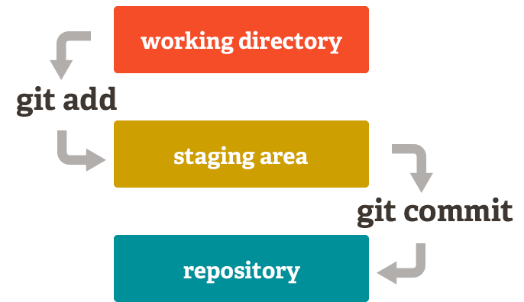
How directory converted into repo

Slide 9
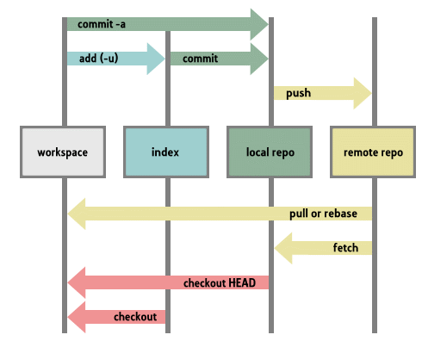
How commits work in git cli

Slide 10
Pulling a repository/editing
lets pull a repository from github
  git pull https://github.com/blackhatabhi/test
  git remote add origin https://github.com/blackhatabhi/test
      I defined the link as origin. No need to write this link every time.
Edit the file a.txt
git commit –am ‘something added’
git push origin

Slide 11

Remove a file
git rm somefile.txt
git commit –m ‘removed’
git push origin

Slide 12
Conflict
git commit -am 'Conflicts resolved‘
Merge conflicts can be an intimidating experience. Luckily, Git offers powerful tools to help navigate and resolve conflicts. Git can handle most merges on its own with automatic merging features. A conflict arises when two separate branches have made edits to the same line in a file, or when a file has been deleted in one branch but edited in the other. Conflicts will most likely happen when working in a team environment.

Slide 13
Go back to old repo
Git log
  Show me the logs git☺
See the commit id
  git reset --hard c1ac571d9af5fe1126ecdf64c57d6ef4a5990a60 && git clean -f
Destroys the local modifications!
Removes untracked files!

Slide 14
One step back!
An easy way to revert last commit (1)
  git revert HEAD~1..HEAD
  git push origin

Slide 15
Don’t want to enter username?
$ git config credential.helper store
$ git push http://example.com/repo.git
Username: <type your username>
Password: <type your password>

Slide 16
Ending
THANKYOU SO MUCH
MADE WITH ❤ BY
Abhinav Kumar
A40318046
Btech Cse general grp 1.

